Slide 1
Last Year
2022-2023 Budget Performance
Expenses
$29,785,817
Revenues
$29.784,572
Difference
$(1,245)

Slide 2
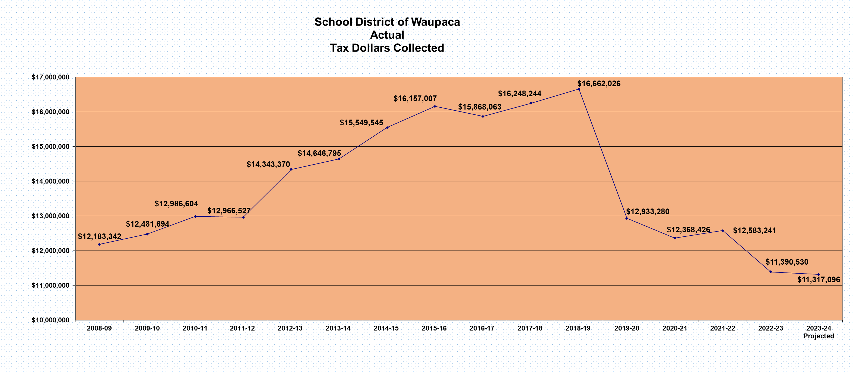
2023-2024 Projected Taxes

Slide 3
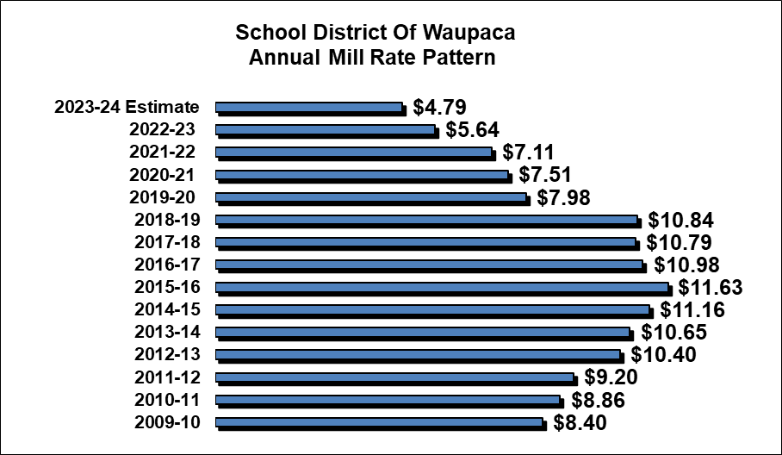

Slide 4
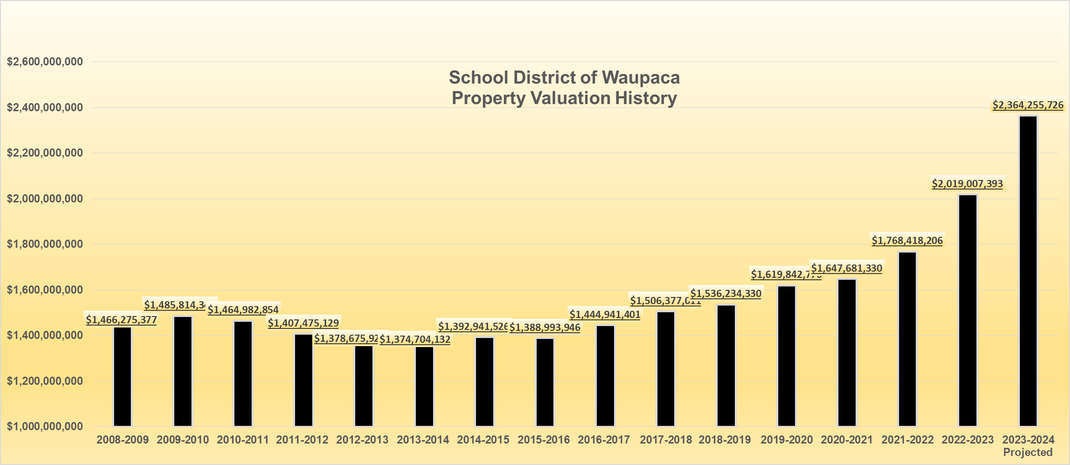

Slide 5

Historical Pupil Head Count

Slide 7
2023-2024 is a
Balanced Budget
Fund 10
$28,665,997 Revenues
$28,665,997 Expenses

Slide 12
The importance of a healthy Fund balance

Slide 13
Coming attractions 2024-2025
ESSER 3 Funded salary Positions of $360,000 will be done
Meaning: The 2024-25 Budget can not support these positions any longer or the equivalent of other positions in this amount will have to be reduced or the 2024-2025 budget will not balance.
Salary positions are compounded expenses
Anything New, any added percentage increase for any annual item, increases the budget by that amount forever unless an ongoing annual budget reduction is made in the same amount.

Slide 14
Budget summary
Property taxes going down (.64%)
Tax Mill Rate per 1000 of property value going down ($0.85) per 1000
Property Valuation going up 17.1%
Student Enrollment going up 22 FTE
Open Enrollment Student Count net Minus (18) FTE
The 2023-2024 Budget is Balanced
The District’s Fiscal House is in Order

